Slide 1
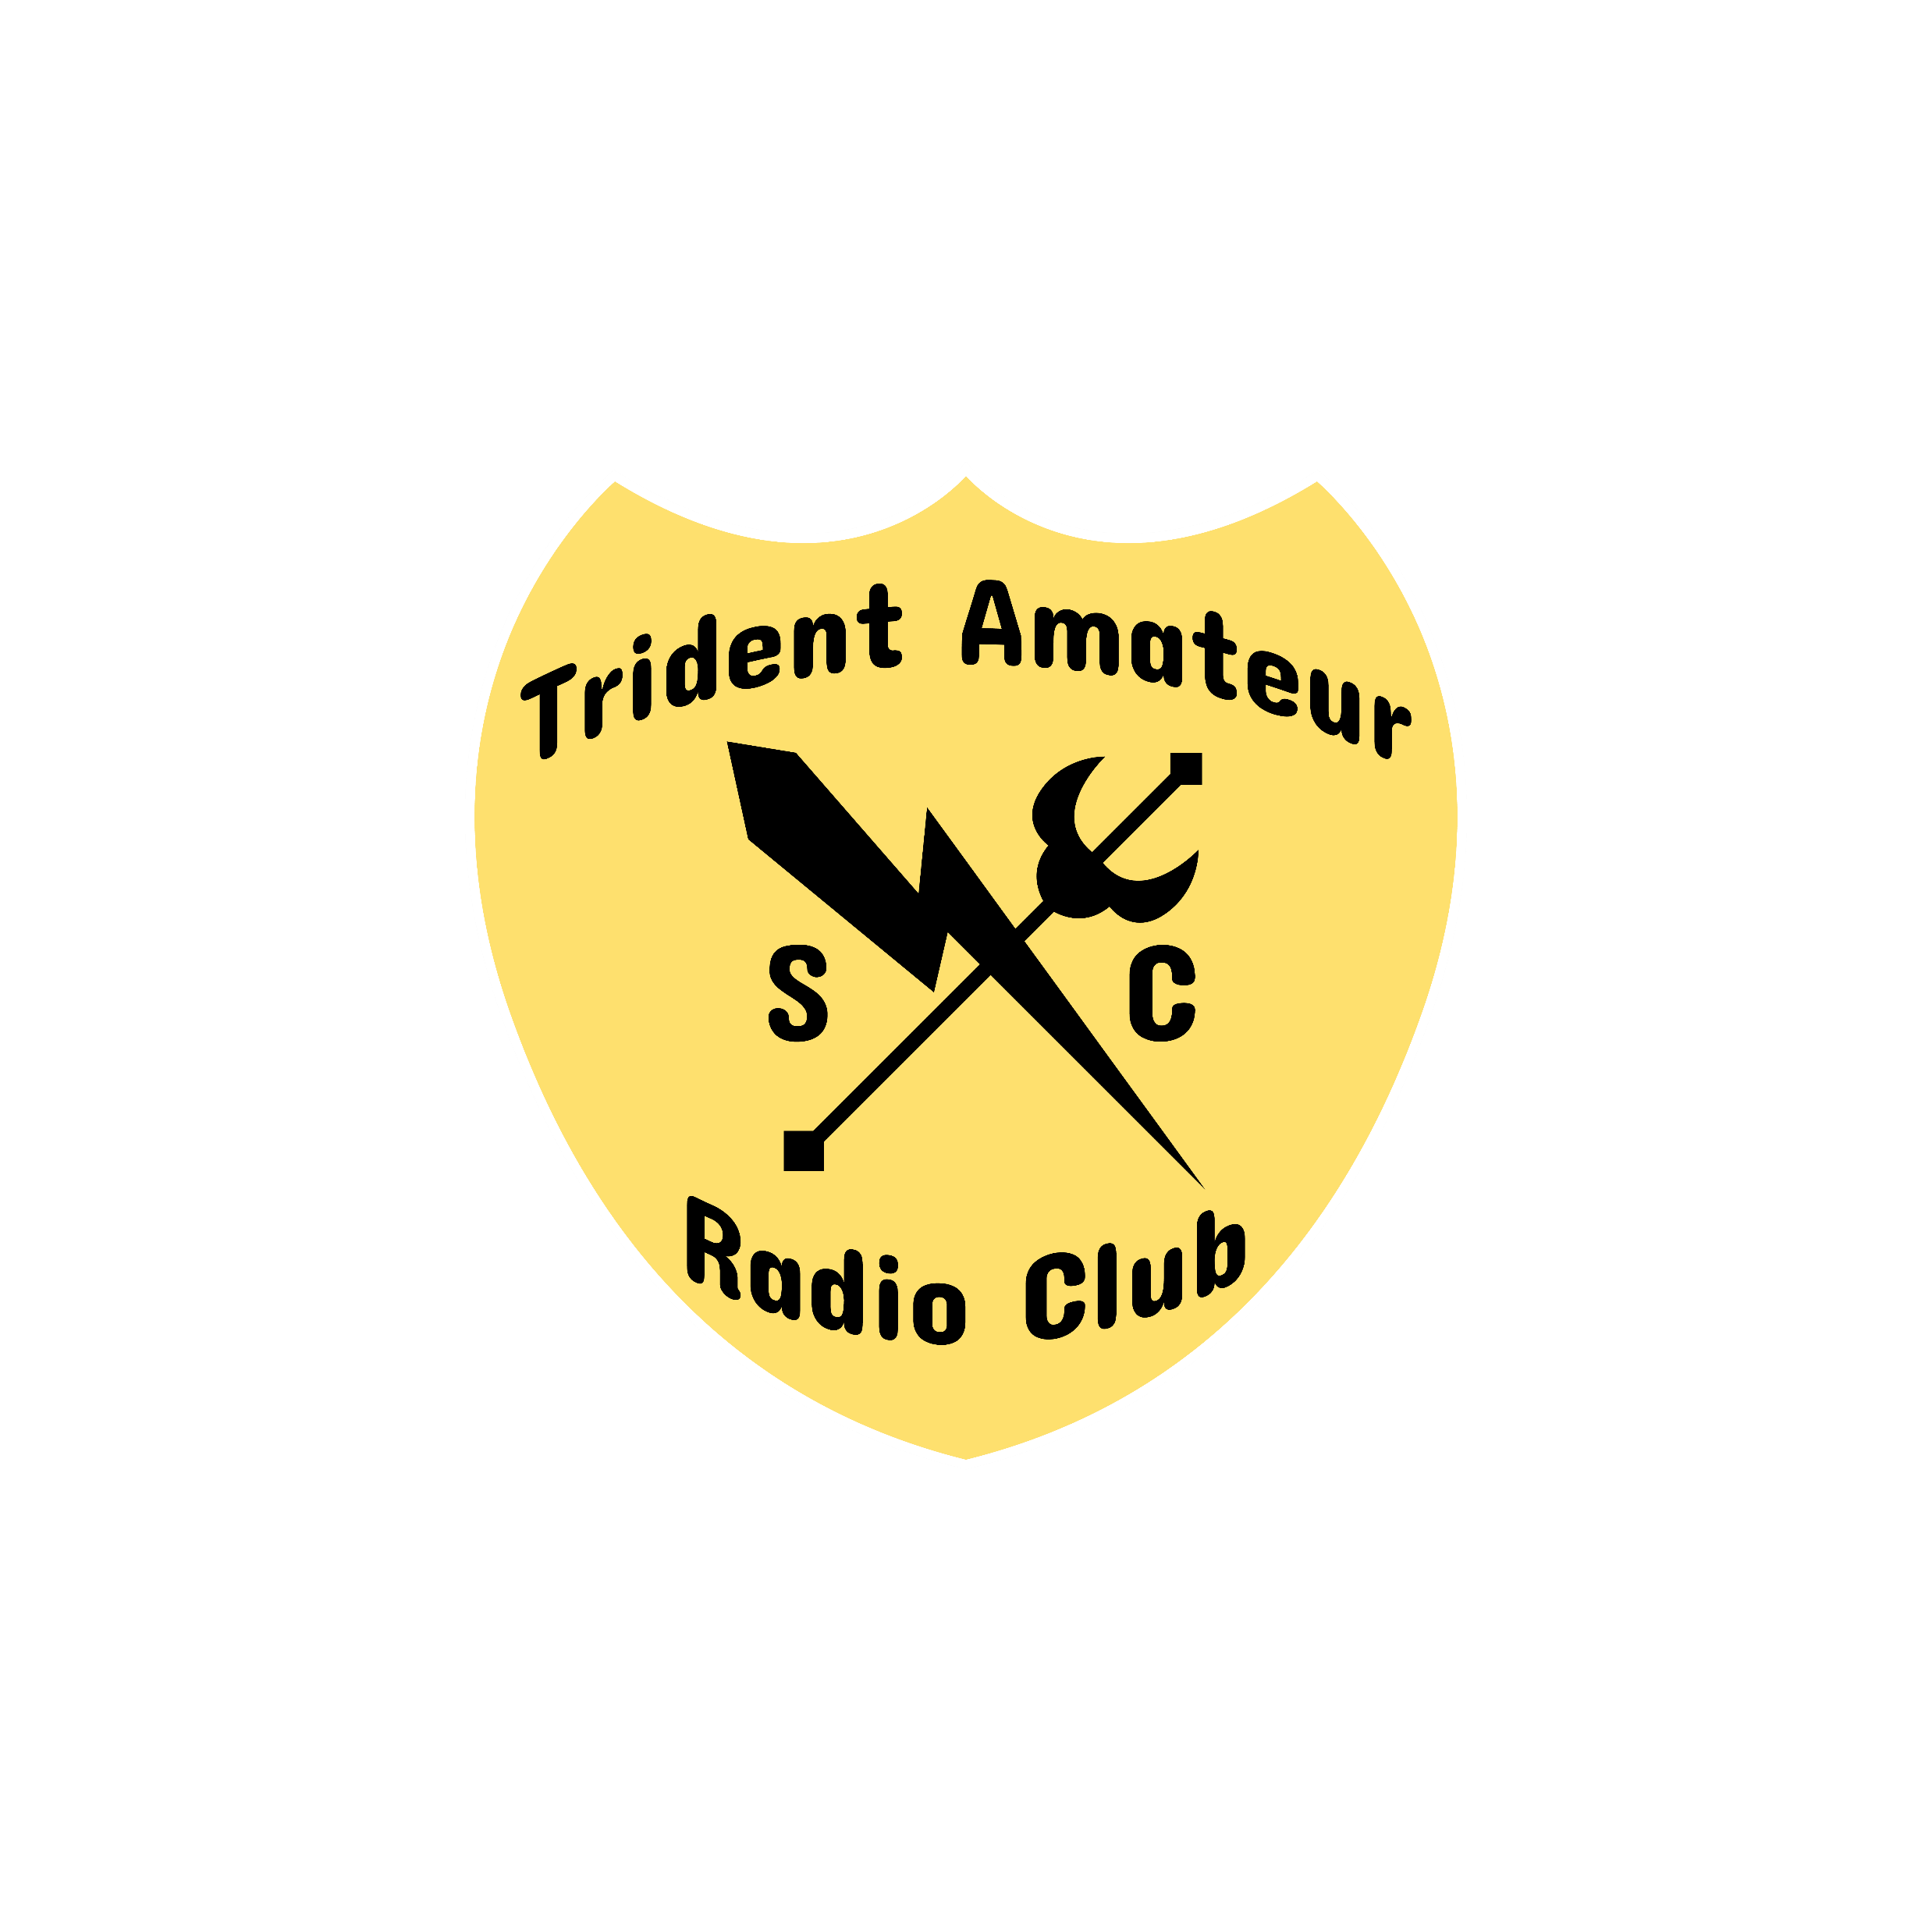
TARC N3FJP Logging (Field Day)
Ron Davis – K4TCP
Special thanks to Steve Behr - K4OPZ

Slide 2
What is Logging? What is N3FJP?

Slide 3
Select Band, Mode and Operator.
Selection is persistent
Designed for quick data entry
Rig control or CAT (computer aided transceiver)
It's a non-generic serial protocol used by radio amateurs to remotely control transceiver radio receiver equipment using a computer.
This allows for automated operation and control of radio equipment.

Slide 4
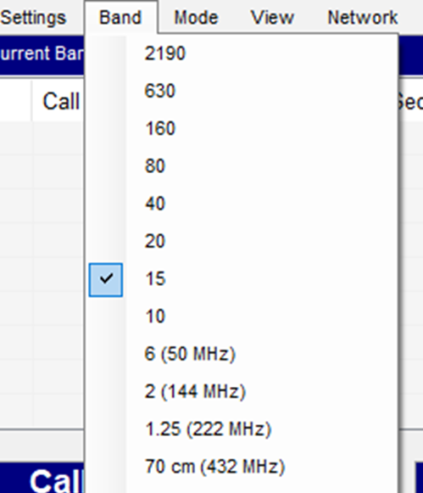

Slide 6
Why set the operator?
This allows us to identify who made the log entry in the event there is a question later.
It also gives you a way to track your QSOs if you want
Two easy ways

Slide 7
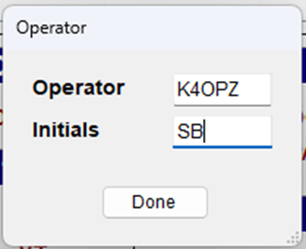

Slide 8
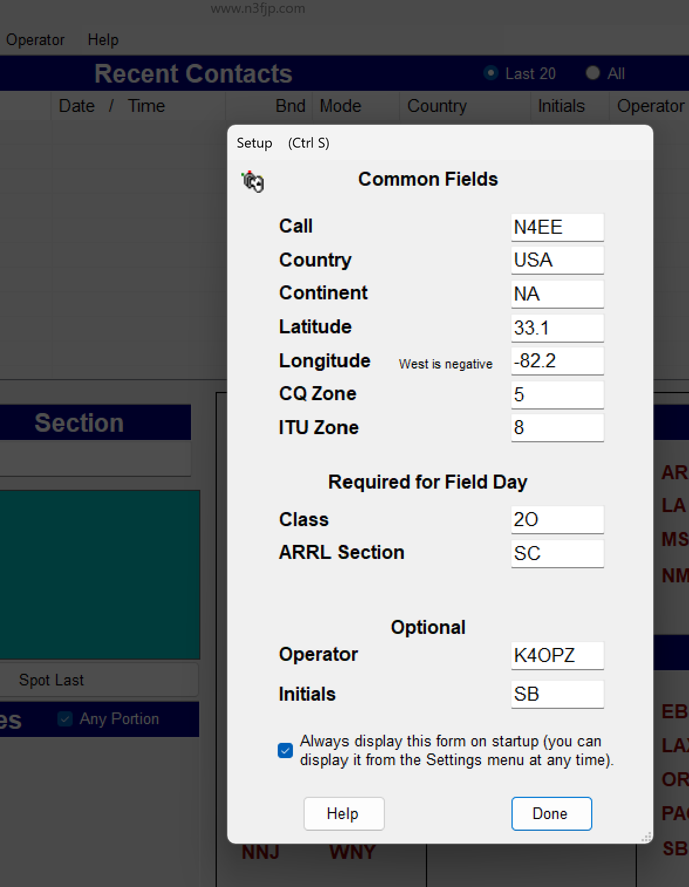

Slide 9
Rig Control aka CAT
Allows communication to/from the transceiver/computer.
For logging can automatically pull over key information
Frequency ie 14.262 MHz
Mode ie USB
Other info if configured

Slide 10
Field Day logging (Winter vs Summer Field Day)
Things to log
Frequency/band
Mode
Exchange
Exchange example:
2A SC
Section SC for South Carolina
Class 2A – 2 transmitters, A = Battery

Slide 11
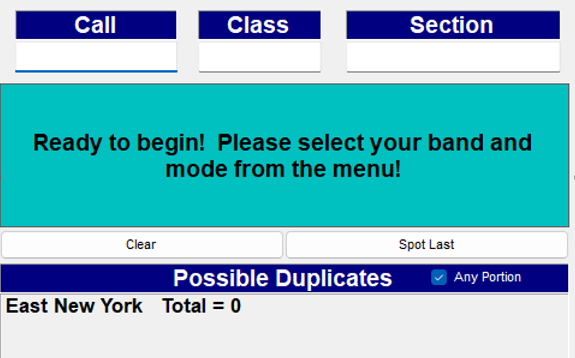
Field Day logging (Winter vs Summer Field Day)
Things to log
Frequency/band
Mode
Exchange
Exchange example:
2A SC
Section SC for South Carolina
Class 2A – 2 transmitters, A = Battery
Class 2A – 2 transmitters, A = Battery

Slide 12
Field Day logging (Winter vs Summer Field Day)
Things to log
Frequency/band
Mode
Exchange
Exchange example:
2A SC
Section SC for South Carolina
Class 2A – 2 transmitters, A = Battery

Slide 13
Field Day logging (Winter vs Summer Field Day)
Things to log
Frequency/band
Mode
Exchange
Exchange examples:
KD4JPL
2A
SC

Slide 14
Field Day logging (Winter vs Summer Field Day)
Things to log
Frequency/band
Mode
Exchange
Exchange examples:
KD4JPL
2A
SC

Slide 15
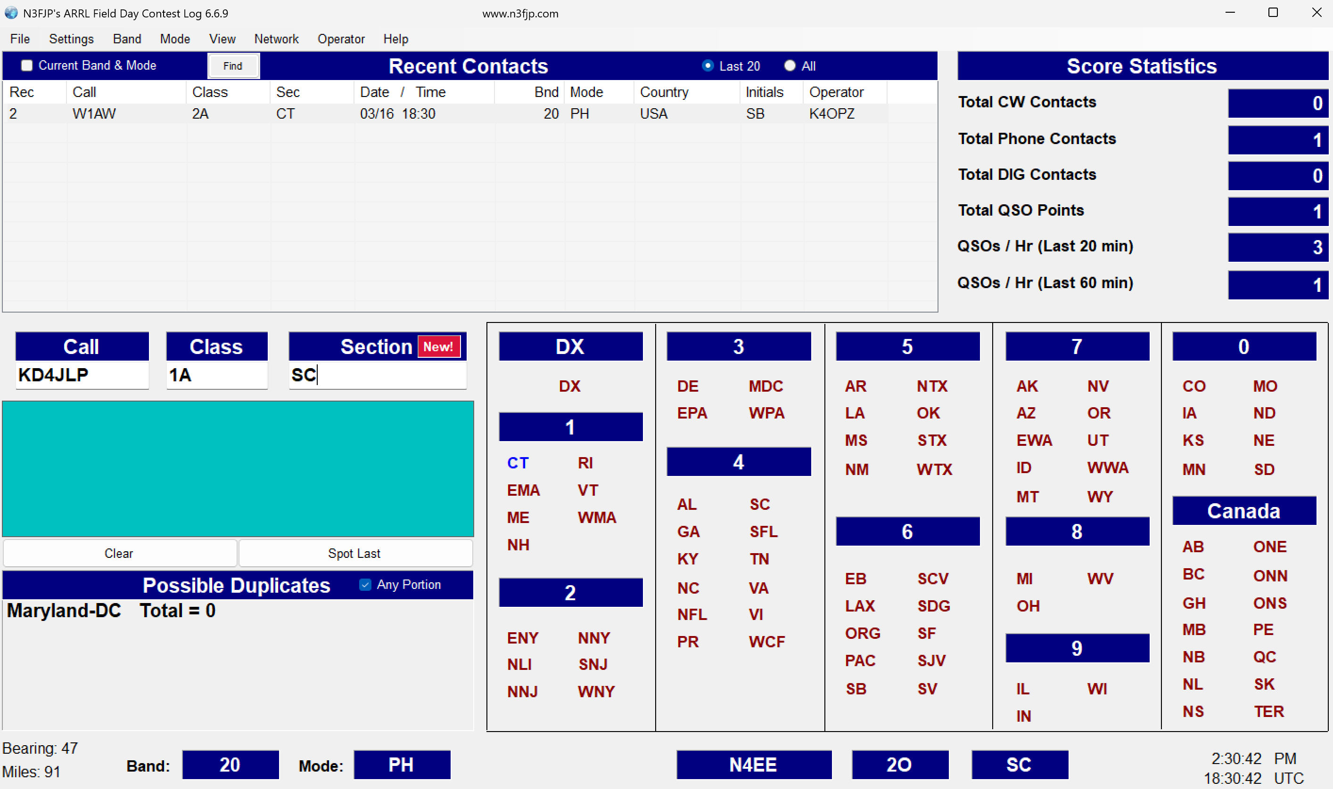

Slide 16
Press ENTER
No need to “SAVE” the software automatically updates the database after you press enter.
When finished with your session close as normal.
Do not alter or move the database files.
Questions???

